Slide 1
Electron Spin Resonance
Christopher Jacobs
Ben N., Micah l.

Slide 2
Background
The electron has a dipole moment that is related to its angular momentum (spin)
The g-factor is a constant characteristic of the electron relating these two quantities
A magnetic field can interact with a dipole moment flipping an electrons orientation
can only be oriented in two ways due to its quantum nature

Slide 3
Goal
Take advantage of the relationship between the magnetic dipole moment and angular momentum (spin) of an electron to find an experimental value of the g-factor
Prediction: g-factor will have a value of 2.0023 (one of the most precise measurements in physics!!!)

Slide 4

Experimental set up
Front view of Helmholtz Coil
$$\overset{→}{B}$$
Free electron
Sample of DPPH surrounded by a coil
N
N
Distance = Radius (.068m)
DPPH Molecular representation

Slide 5

Experimental set up
Channel 2
Side View of Helmholtz coil
DPPH Sample
Control unit
Probe: ability to change frequency
Frequency
Connects to oscilloscope:
Channel 2
Channel 1
$\overset{→}{B }$ uniform between the coils
Ammeter

Slide 6
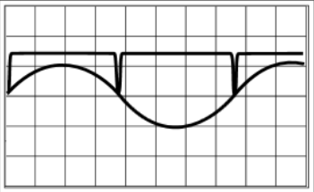
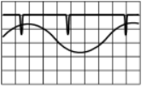
Experimental Set up
Knobs that allow adjustment of sensitivity and sweep rate
The oscilloscope
represents when the electron takes energy (the dips)
DC and AC current super positioned
Channel 1
Channel 2

Slide 7
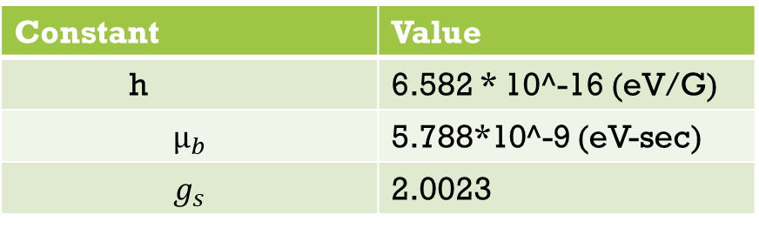
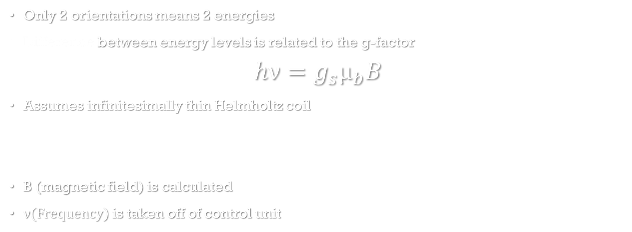
Calculations
Only 2 orientations means 2 energies
Difference between energy levels is related to the g-factor
$$hν=g_{s}μ_{b}B$$
Assumes infinitesimally thin Helmholtz coil
B (magnetic field) is calculated
ν(Frequency) is taken off of control unit
Constant | Value
h | 6.582 * 10^-16 (eV/G)
$$μ_{b}$$ | 5.788*10^-9 (eV-sec)
$$g_{s}$$ | 2.0023

Slide 8
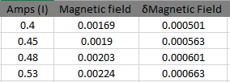
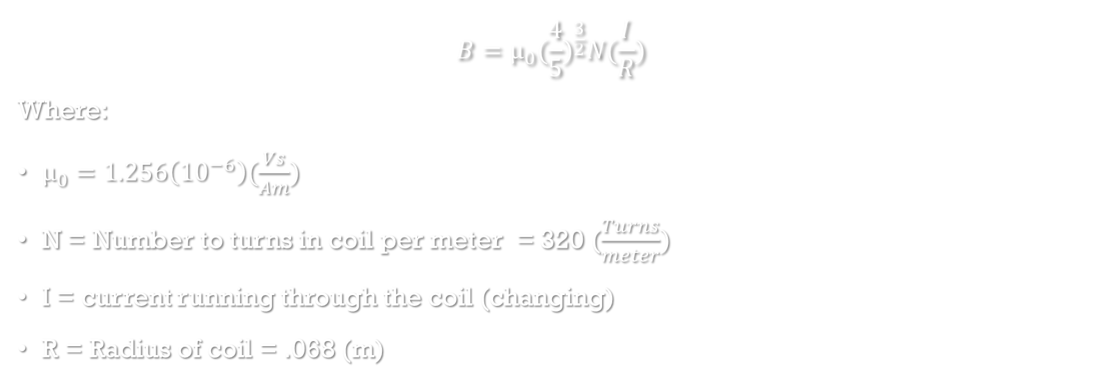
Finding The magnetic Field
$$B=μ_{0}({\frac{4}{5})}^{\frac{3}{2}}N(\frac{I}{R})$$
Where:
$μ_{0}=1.256\left({10}^{−6}\right)(\frac{Vs}{Am})$
N = Number to turns in coil per meter = 320 ($\frac{Turns}{meter})$
I = current running through the coil (changing)
R = Radius of coil = .068 (m)

Slide 9
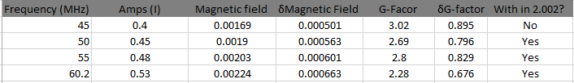

G-Factor Calculation
$$hν=g_{s}μ_{b}B$$
$g_{s}$=($\frac{hv}{μ_{b}B})$
Where:
h= $6.582({10}^{−16})(\frac{eV}{G})$
$v$= frequency(dampened)
$μ_{b}=5.788({10}^{−9})(eVsec$)

Slide 10
Future Work
Use an infinitesimally thin coil
Use a model that takes into account thickness of coil
Create a perfect Helmholtz coil
Center the DPPH perfectly in the coil
Use other materials that are not DPPH for reproducibility

